Slide 1
APPLICATION OF FLOYD-WARSHAL’S ALGORITHM IN AIR FREIGHT SERVICES USING PYTHON. PRESENTED By:
AYENI, OLARINDE LUCAS
Codename Vincode
PYCON NIGERIA
PYCON,2018
SEPTEMBER ,2018

Slide 2
About me: Software Developer. B.sc Computer Science @ Landmark University. A serving copper @ eket akwaibom state Pioneer lecturer of the Department of Computer science in New Age College of Science and Technology Eket, Computer teacher in Girls High School, Eket, Akwaibom State.(PPA) phone: 07030779952

Slide 3
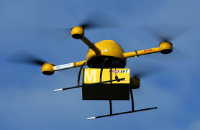
RELEVANCE OF THE STUDY
Freights can simply be referred to as goods transported usually in bulk whether by ship, trains, trucks or aircraft. Air-freight: a system of transporting goods which can be commercial or non-commercial by aircraft.

Slide 4
RELEVANCE OF THE STUDY
Air freight services: Essential mode of transport for low density and relatively high-value commodities such as newspapers, parcels, perishable/short-lived products, precious metals and gemstones and low volume parcels. (BITRE, May 2014).
Advantages include: Fastest means of transportation, Quick deliver of time-sensitive and perishable goods to end buyers, Urgency in transporting some goods especially those for commercial purpose which are highly demanded by consumers will have no other better means of transport order than Air-Freight.

Slide 5
CHALLENGES:
Aircraft can travel for a certain number of kilometres to deliver freight form one location to another.
Higher Cost incurred due to frequent stop overs for refuelling when traveling long distance
The problem however, is an optimization problem to cut down the distances travelled, minimized number of stops-over so as to optimize the time for delivery of time-sensitive goods and minimize the total cost.

Slide 6
TERGETS:
The main goal of this research work is to apply Floyd Warshall’s algorithm to air freight services and the objectives are to:
1. Implement the Algorithm using PYTHON.
2. Suggest optimal routes to minimize costs and save time.

Slide 7
ADDITIONAL INFO
Intelligent navigation systems know the current location using GPS and guide cars along the shortest route to minimize travel time, distance, or fuel and energy consumption. Some of these systems also react to changing traffic conditions and, in the future, cars may communicate with each other and negotiate routes to regulate the overall traffic flow and manage congestion. The end users are often interested in trip planning, which means that they want to know the distance and the shortest, cheapest, or most reliable path between two specific points. (C Sommer, 2010)

Slide 8
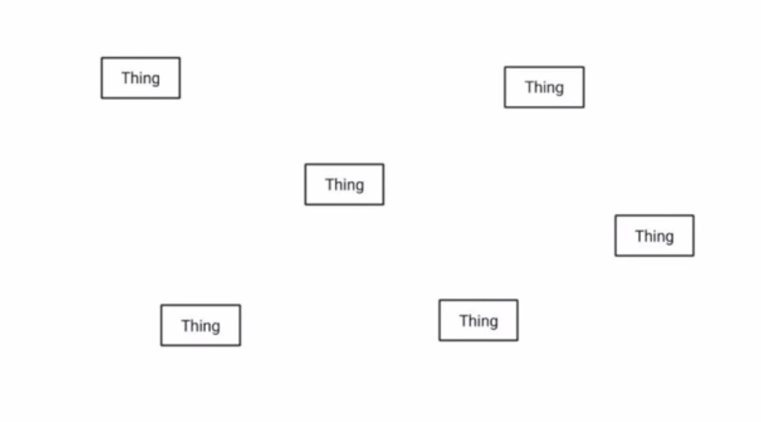
Shortest Path Problem:
Shortest Path Problems are Graph problem

Slide 9
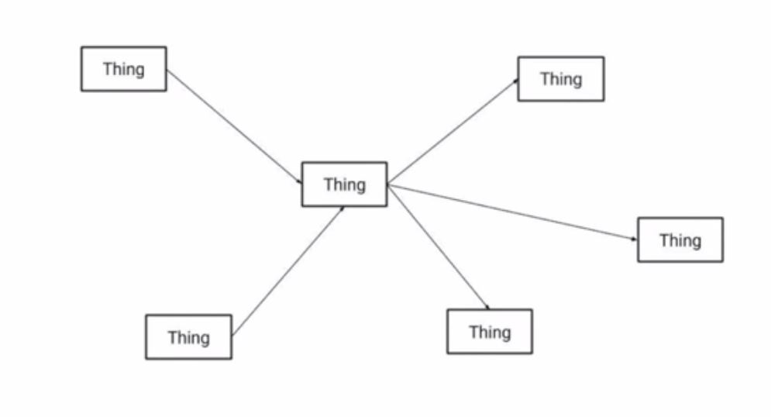
Shortest Path Problem:
Shortest Path Problems are Graph problem

Slide 10
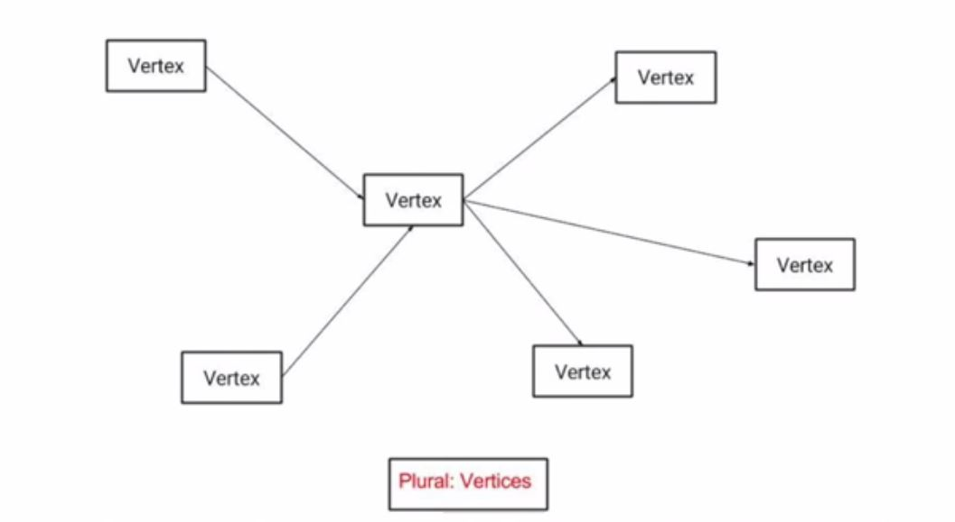
Shortest Path Problem:
Shortest Path Problems are Graph problem

Slide 11
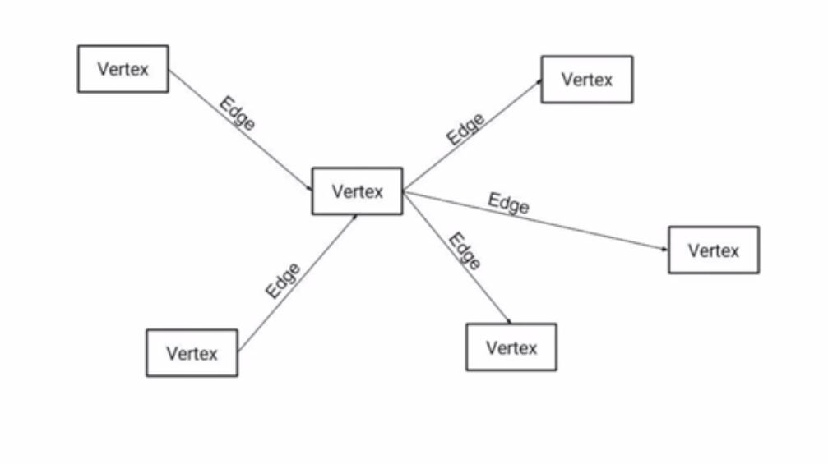
Shortest Path Problem:
Shortest Path Problems are Graph problem

Slide 12
Shortest Path Problem:
Shortest Path Problems are Graph problem
The Suppose we are given a directed graph G=(V,E) and a weight function w: E->R. We assume that G does not contain cycles of weight 0 or less.
The All-Pairs Shortest Path Problem asks to find the length of the shortest path between any pair of vertices in G.
This yields an O(n3) algorithm on graphs with N vertices

Slide 13
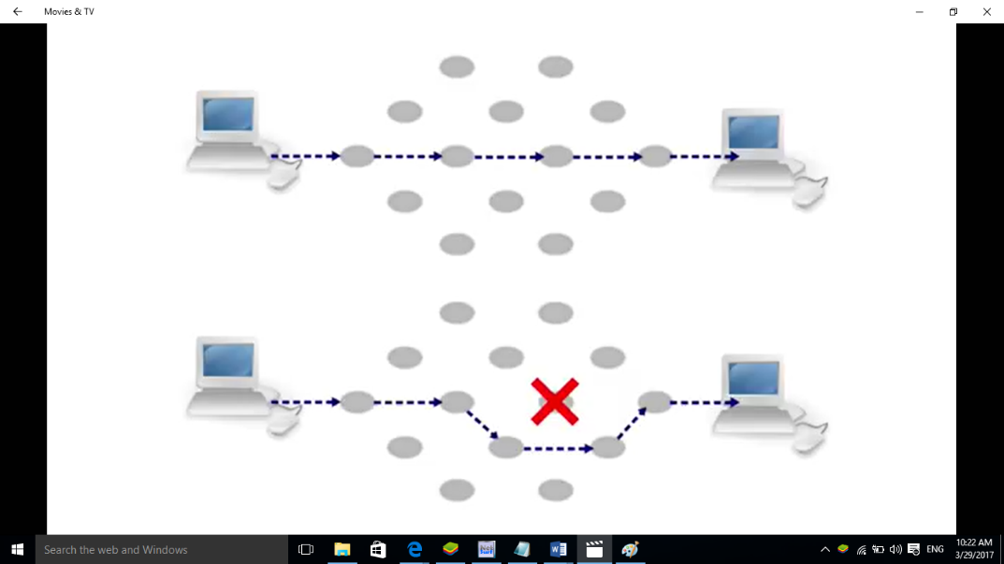

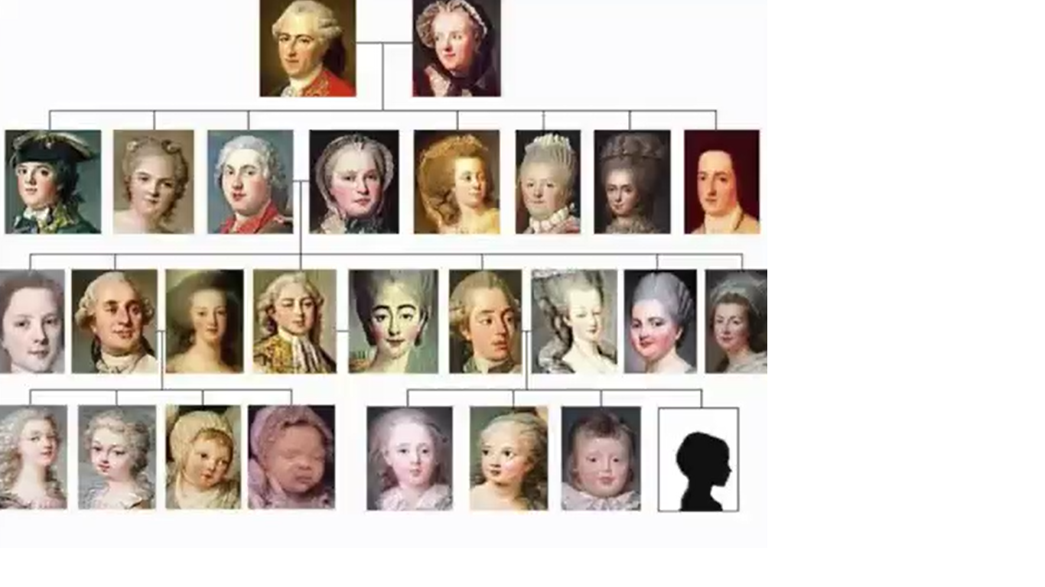
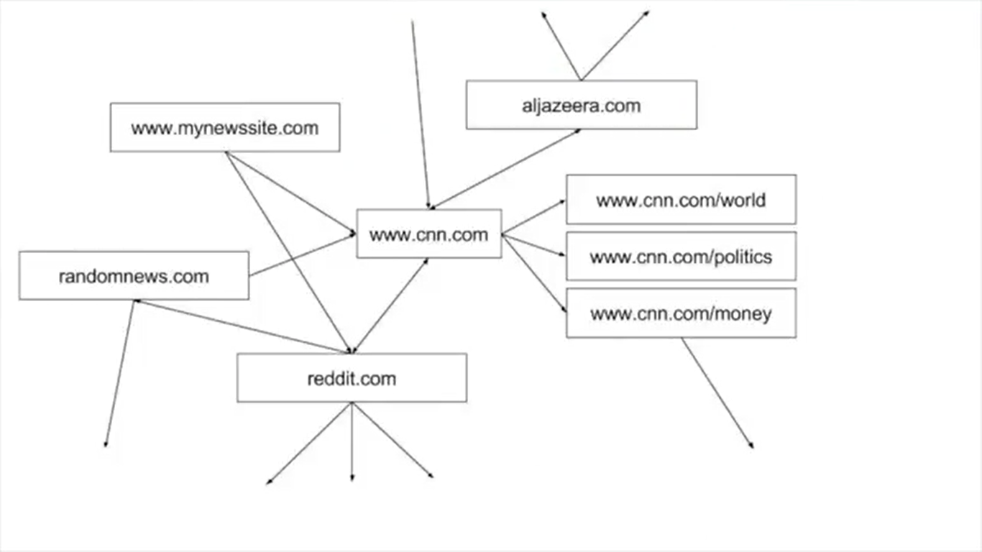
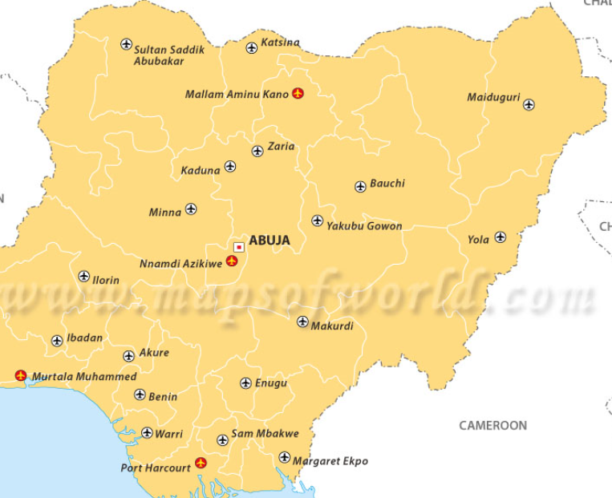
Graph:

Slide 14
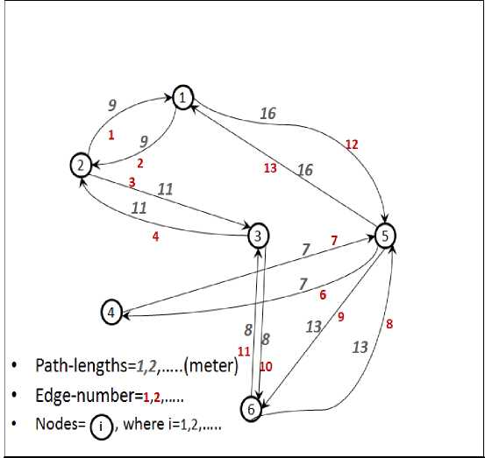
Representation of Graph
 | abuja | lokoja | kano | calaba | ekiti | lagos
abuja | 0 | 219 | 300 | 245 | 210 | 192
lokoja | 119 | 0 | 11 | 22 | 98 | 217
kano | 219 | 111 | 0 | 132 | 209 | 201
calaba | 200 | 187 | 999 | 0 | 7 | 292
ekiti | 116 | 90 | 319 | 265 | 0 | 113
lagos | 301 | 300 | 201 | 292 | 113 | 0
1. Graph 2. Adjacency Matric

Slide 15
Floyd-Warshall Algorithm
Floyd-Warshall(W)
n = numbers of rows of W;
D(0) = W;
for k = 1 to n do {
for i = 1 to n do {
for j = 1 to n do{
d_{ij}(k) = min{d_{ij}(k-1) , d_{ik}(k-1) + d_{kj}(k-1)};
}
}
}
return D(n);

Slide 16
HOW IT WORKS
Consider a shortest path P from i to j such that the intermediate vertices are from the set {1,…,k} then;
If the vertex k is not an intermediate vertex on the path P, then d_{ij}(k) = d_{ij}(k-1)
If the vertex k is an intermediate vertex on the path P, then d_{ij}(k) = d_{ik}(k-1) + d_{kj}(k-1)
Interestingly, in either case, the subpaths contain merely nodes from {1,…,k-1}.

Slide 17
Deduction:>
Therefore, we can conclude that
d_{ij}(k) = min{d_{ij}(k-1) , d_{ik}(k-1) + d_{kj}(k-1)}
k
Abj
LKJ
EKITI
IBADAN
Lag
akure

Slide 18
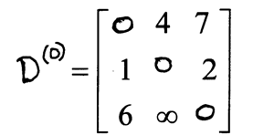
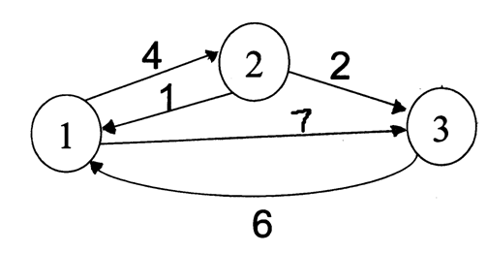
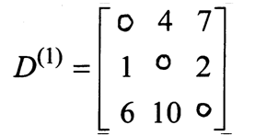
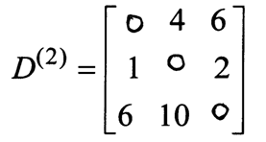
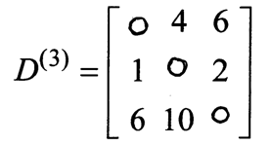
Floyd Warshall Algorithm - Example
Original weights.
Consider Vertex 1:
D(3,2) = D(3,1) + D(1,2)
Consider Vertex 2:
D(1,3) = D(1,2) + D(2,3)
Consider Vertex 3:
Nothing changes.

Slide 19
ALL YOU NEED
Python programming language Version 3.2
Framework: Flacks
GUI: Tkinters
IDE : PyCharm
Lib: NetworkX is a Python-based package for the creation, manipulation, and study of the structure, dynamics, and functions of complex networks.
The Jupyter Notebook is an open-source web application that allows you to create and share documents that contain live code, equations, visualizations and explanatory text. Uses include:numerical simulation, statistical modeling, machine learning and much more.

Slide 20
Conclusion:
This study will contribute greatly to the ease of air freight service development planning.
To save time and significantly reduce cost of refuelling. Moreover, the resultant program from this study can be integrated with organizations' information systems and facilitate internal reporting and customer service processes.
Demonstrating the application of Floyd Warshall’s algorithm which will grant PYTHONISTAS a better understanding of the algorithm.

Slide 21
REFERENCE
Review and Performance Analysis of Shortest Path Problem Solving Algorithms, International Journal on Advances in Software, vol7 nol&2, 2014, http://www.iariajournals.org/software/
PRITAM, KHAN. (may 2014).Modification Of Floyd-warshall’s Algorithm Into A Shortest Path Algorithm Applicable For Routing InWireless Sensor Networks
Shad, R., Ebadi, H. and Ghods, M. (2003). Evaluation of Route Finding Methods in GIS Application, Presented in Map Asia Conference 2003.
http://www.maxburstein.com/blog/introduction-to-graph-theory-finding-shortest-path, February 2013.
Timothy M. Chan, ―All-pairs shortest paths with real weights in O(n3/log n) Time‖, Algorithmica, 50:236–243, 2008

Slide 22


Slide 23


